Slide 1
Example Manager: Sandbox Search
By Vanessa Wang
August 11, 2020

Slide 2
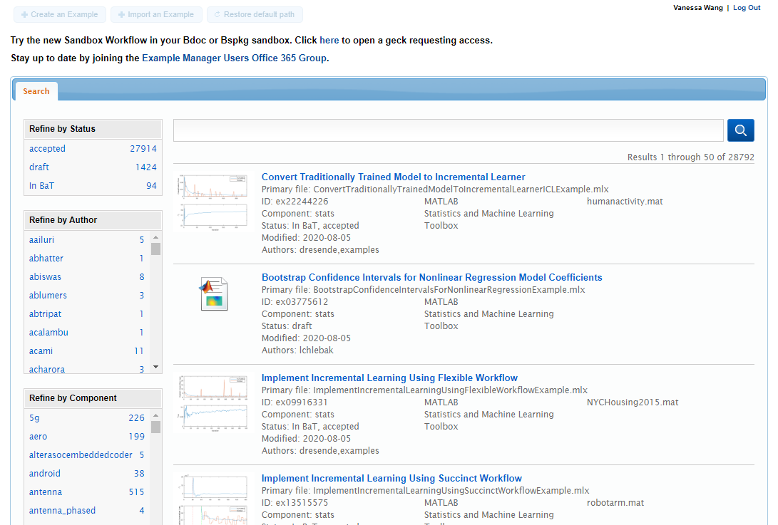
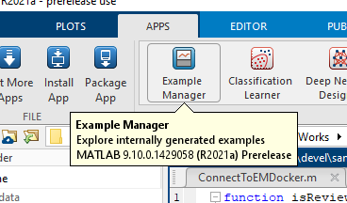
Example Manager v1
Internal app: “authoring, storing, and managing customer-facing examples”
https://inside-apps.mathworks.com/example-manager

Slide 3
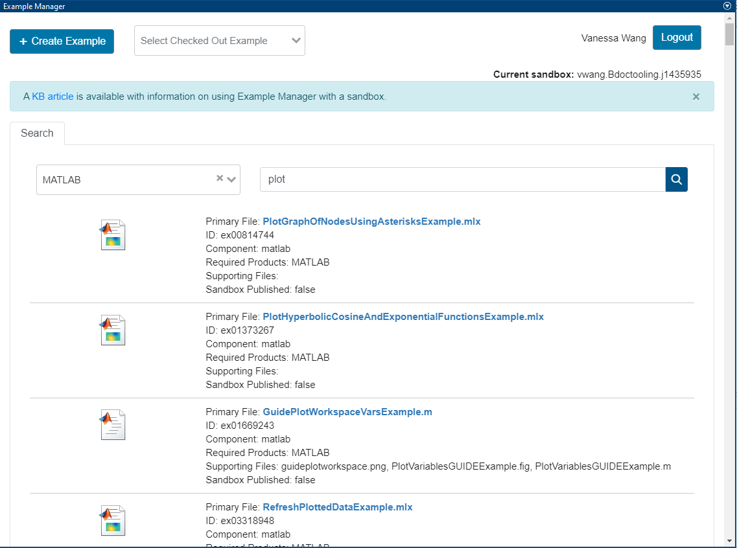
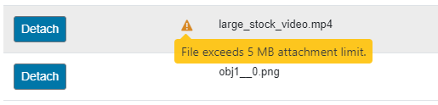

Example Manager v2
Sandbox Workflow
Submit examples based on a user’s sandbox
New UI (Vue)
Features
File size notification warning
Major feature: searching

Slide 4



Search Libraries
Example Manager v1
Server-based (Solr): all share one index
Sandbox workflow: local index for each sandbox
Finding a new library
Supports full text search and faceted search
IAT (Infrastructure, Architecture, and Tools) team
Languages already supported in BaT highly preferred
Go-based tool?
Bleve
http://blevesearch.com/
“Full-text search and indexing for Go”

Slide 5
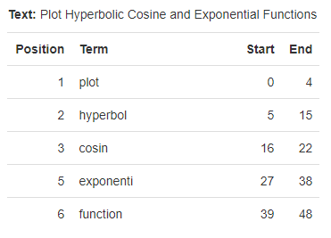
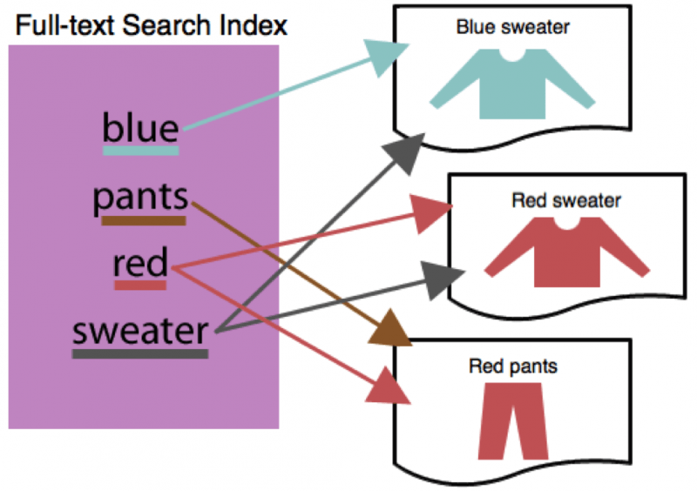
Building a Search Index
http://analysis.blevesearch.com/analysis
Full text search
Search over an index
Acquire data
Metadata for each example
Create mapping
Determines how to interpret fields
Index data
Parse data and create a list of “terms”
Maps queries to documents
https://blog.couchbase.com/secondary-indexes-or-full-text-search/

Slide 6

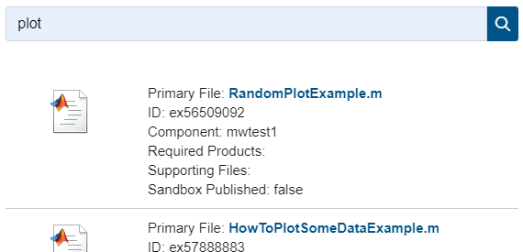
How to make Queries
“plot”

Slide 7

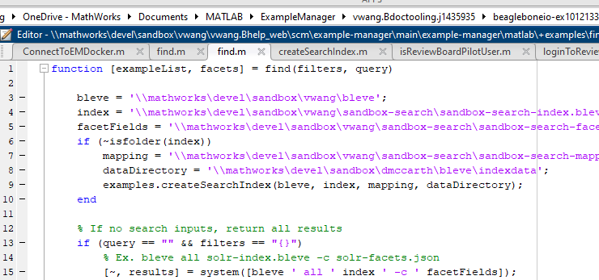
How to make Queries
“plot”
MATLAB Connector
“sandbox\bleve.exe query search-index.bleve plot”

Slide 8
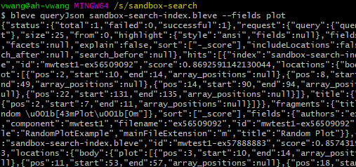
How to make Queries
“plot”
MATLAB Connector
“sandbox\bleve.exe query search-index.bleve plot”
Run Bleve command using system(…)
hits: [
fields: {
id: “ex84464905”,
title: “Plot After Optimization”,
component: “stats”,…
},
fields: {
id: “ex56295480”,
title: “Creating 2-D Plots”,
component: “matlabmobile”,…
},…
]
Querying index…

Slide 9
How to make Queries
hits: [
fields: {
id: “ex84464905”,
title: “Plot After Optimization”,
component: “stats”,…
},
fields: {
id: “ex56295480”,
title: “Creating 2-D Plots”,
component: “matlabmobile”,…
},…
]
JSON string

Slide 10
How to make Queries
struct: [
fields: {
id: “ex84464905”,
title: “Plot After Optimization”,
component: “Statistics”,…
},
fields: {
id: “ex56295480”
title: “Creating 2-D Plots”,
component: “MATLAB Mobile”,…
},…
]
Additional data processing
hits: [
fields: {
id: “ex84464905”,
title: “Plot After Optimization”,
component: “stats”,…
},
fields: {
id: “ex56295480”,
title: “Creating 2-D Plots”,
component: “matlabmobile”,…
},…
]
JSON string

Slide 11
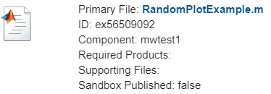
How to make Queries
v-for="example in examples"
Display results
struct: [
fields: {
id: “ex84464905”,
title: “Plot After Optimization”,
component: “Statistics”,…
},
fields: {
id: “ex56295480”
title: “Creating 2-D Plots”,
component: “MATLAB Mobile”,…
},…
]
Return to Vue
Additional data processing
hits: [
fields: {
id: “ex84464905”,
title: “Plot After Optimization”,
component: “stats”,…
},
fields: {
id: “ex56295480”,
title: “Creating 2-D Plots”,
component: “matlabmobile”,…
},…
]
JSON string

Slide 12
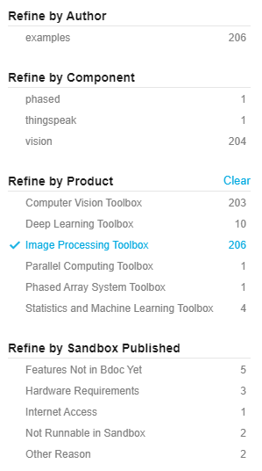
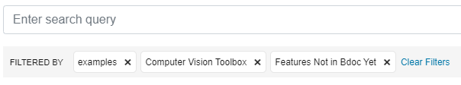
Faceted Search
Faceted Search
Refine search results further
Querying
“plot +authors:kgunasek +component:comm”
MathWorks Web Standards
http://web-standards.mathworks.com/
Components for Front-End Development
Search Nuggets (“Nugget Alley”)
Search Facets

Slide 13
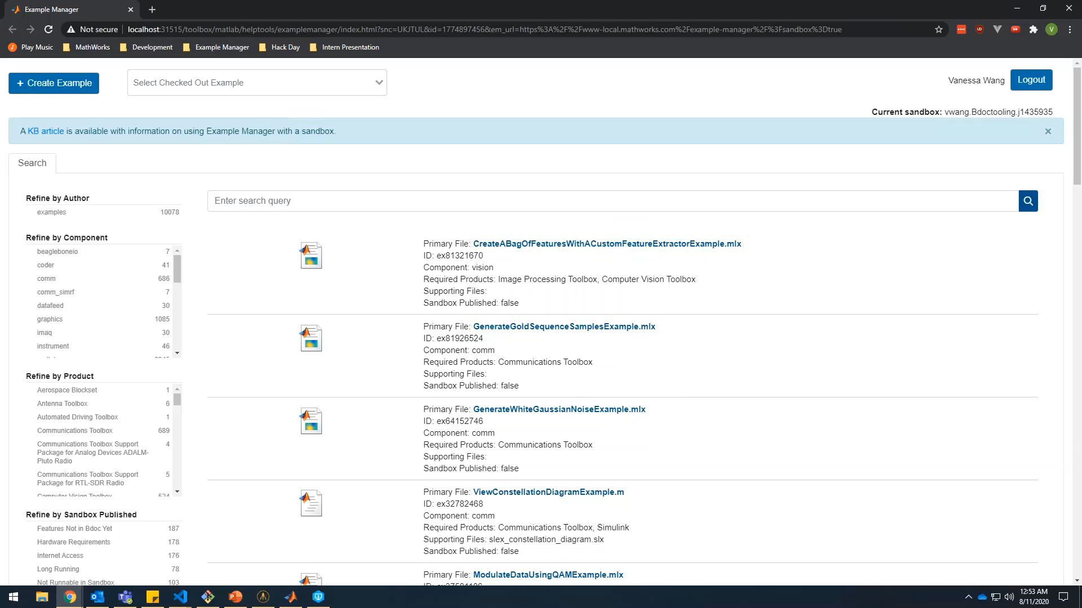
Sandbox Search Demo

Slide 14
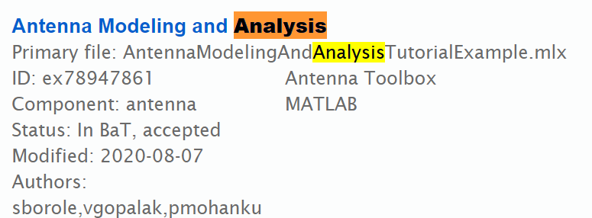
Next Steps
Additional UI features
Pagination, search highlighting
Reduce index size and query speed
Modify the mapping
Documentation
Code sharing with MATLAB Help System project using Bleve
Pagination
Search Highlighting

Slide 15




Things I Learned
New Languages and Tools
Vue, MATLAB, Go
Perforce, Review Board, Gecko
How search libraries work
Working with a third-party library
Researching search libraries
Limited documentation
Open-ended project
Defining goals
Communicating progress
Asking questions

Slide 16
Acknowledgements
Example Manager
Sponsor: Darrin McCarthy
Mentor: Karthik Gunasekaran
QE: Jyoti Shah
UX: Richard Wang
EDG Intern Program
Buddy: Will Fritz
Manager: Elizabeth Reese
All the other interns I met!

Slide 17
Thank You!

